Slide 1
ESTIMATING BODY MASS INDEX THROUGH
FACE RECOGNITION
Project Batch No: 2
Project Guide :
Dr. O. Aruna, _{B.Tech, M.Tech, Phd.}
(Associate Professor)
Team Members:
19BQ1A05E5 - M.Bhavya Sri
19BQ1A05J3 - R.Jyothirmai
19BQ1A05H4 - P.Charitha Sri
19BQ1A05E4 - M.Mano Teja
20BQ5A0518 - N.Vamsi Krishna

Slide 2
Introduction
Body Mass Index (BMI) is a measure of a person's physical health.
From our Literature Survey, we got to know that deep learning models helps for efficient extraction of features and machine learning models for estimating Body Mass Index.
As our project requires both face recognition and feature extraction, we concluded to use FaceNet architecture because it performs better when compared other face recognition architectures.

Slide 3
Proposed Method
Data is analysed from the dataset which we sourced from various resources.
FaceNet architecture is used to identify and extract features from an image
We used three machine learning models which are Ridge Regression, Random Forest Regressor, Support Vector Regressor for the prediction of BMI using extracted features.

Slide 4
Dataset Preparation
For our project, we manually collected images of different actors along with their height and weight details from internet.
We calculated the Body Mass Index values using those height and weight values and stored them in a CSV file.
Our dataset includes 846 images, out of which 408 are male and 438 are female.
We included images from different BMI categories.
Normal 565
Underweight 143
Overweight 128
Severely obese 10

Slide 5
Preprocessing
Before an image is given as input to facenet model to extract features, it is preprocessed.
Image is converted into RGB format and is resized to 160x160 dimensions.
This image is given to Facenet model to get embeddings(or features).

Slide 6
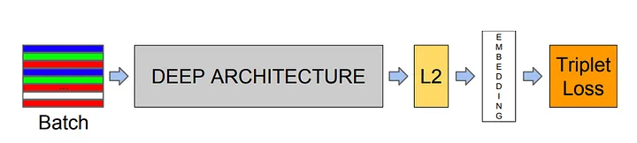
FaceNet
FaceNet is a deep convolutional neural network that is designed generally for face recognition.
In our project, we used facenet for extracting features from images.
Figure 1: Facenet Model Structure
(Source: Research Paper "FaceNet: A Unified Embedding for Face Recognition and Clustering" by Schroff et al.)

Slide 7
(Cont..)
The input to the network is an image, which is then passed through a series of convolutional and pooling layers to extract features.
The last fully connected layer of the network is responsible for generating a 128-dimensional embedding vector for each input face image.
The embedding layer is connected to the L2 normalization layer.
FaceNet has totally 22 layers, where each layer takes input feature map from the preceding layer’s output.

Slide 8
(Cont..)
The 22 layers can be grouped into several types of layers. They are as follows:
Convolutional layer
Normalization layer
Max pooling layer
Global pooling layer
Concat layer
Fully connected layer
L2 normalization layer

Slide 9
Convolution Layer
↓
Pooling Layer
↓
Normalization Layer
↓
Convolution Layer x2
↓
Normalization Layer
↓
Pooling Layer
↓
Convolution Layer x2
↓
Pooling Layer
↓
Convolution Layer x6
↓
Global Average Pooling Layer
↓
Concat Layer
↓
Fully Connected Layer x3
↓
L2 Layer
FaceNet Architecture

Slide 10
Ridge Regression
If the machine learning model performs well with the training data but does not perform well with the test data then the model is said to be overfitted.
Ridge regression is a variant of linear regression in which a small amount of bias is added to get better prediction.
It is used to reduce the complexity of the model and it is also called as L2 regularization.

Slide 11
(Cont..)
This technique can be used in such a way that it will maintain all features in the model by reducing the weight of the features.
Cost Function for Ridge Regression:
Ridge = Loss + α*||W||²
where, ||W||² = w₁²+w₂²+......+w_{n}²

Slide 12
(Cont..)
The cost function is altered by adding the penalty term to it.
The amount of bias added to the model is called Ridge Regression penalty.
It is calculated by multiplying with the alpha to the squared weight of each individual feature.
A general linear regression will fail if there is high collinearity between the independent variables, so to solve such problems, Ridge regression is used.

Slide 13
Random Forest Regressor
Random Forest is an ensemble technique that combines multiple decision trees in determining the final output rather than relying on individual decision trees.
In the case of a classification problem, the final output is taken by using the majority voting classifier.
In the case of a regression problem, the final output is the mean of all the outputs.

Slide 14
(Cont..)
Sklearn module is used to train random forest regression model, using the RandomForestRegressor function.
The following are some of the parameters that are used:
n_estimators — the number of decision trees you will be running in the model
max_depth — this sets the maximum possible depth of each tree

Slide 15
(Cont..)
We used hyperparameter tuning, that is finding the best combination of parameters that can be used.
Using Scikit-Learn’s RandomizedSearchCV method, we can define a grid of hyperparameter ranges, and randomly sample from the grid, performing K-Fold CV with each combination of values.
N_iter is the number of different combinations to try, and cv is the number of folds to use for cross validation

Slide 16
Support Vector Regressor
Support Vector Regression (SVR) uses the same principle as SVM, but for regression problems.
The goal of the SVR algorithm is to create the best line or decision boundary that can segregate n-dimensional space into classes so that we can easily put the new data point in the correct category in the future. This best decision boundary is called a hyperplane.

Slide 17
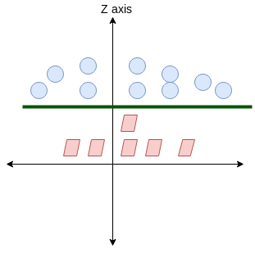
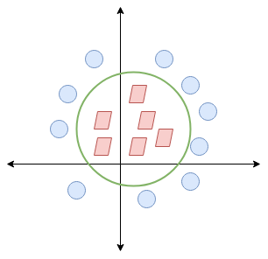
(Cont..)
Figure 2: Support Vector Regression
(Source: cdn.analyticsvidhya.com )

Slide 18
(Cont..)
Kernel is used to find a hyperplane in the higher dimensional space without increasing the computational cost as it increases if the dimension of the data increases.
Kernel has different types like linear, poly, rbf, sigmoid, precomputed. If the type of kernel is not mentioned, the default is rbf(radial basis function).
Radial basis kernel uses exponent and gives a polynomial equation of infinite power which makes our model more effective.

Slide 19
Results and Discussions
We used Facenet to extract features which are then used to train regression models like Ridge Regression, Random Forest Regression and Support Vector Regression resulting in accuracies of 88.84%, 91.9%, and 89.21% respectively. An image input is taken and height, weight, bmi of the person in image is generated as output using the trained models. We will also work on implementing the Kernel Ridge regression model and try to improve the efficiency of our model.

Slide 20
(Cont..)
Ridge Linear Regression:
Accuracy = 88.84%.
Variance score: 0.56
Random Forest Regression:
Accuracy = 91.90%.
Variance score: 0.74
Support Vector Regression:
Accuracy = 89.21%.
Variance score: 0.69

Slide 21
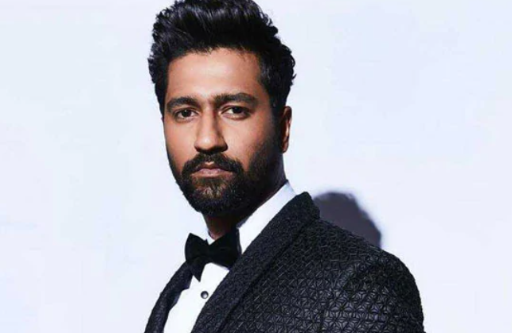
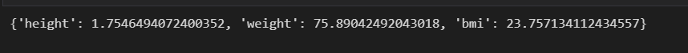
Prediction on Training Image

Slide 22

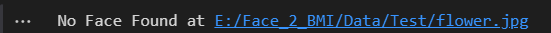
(Cont..)

Slide 23

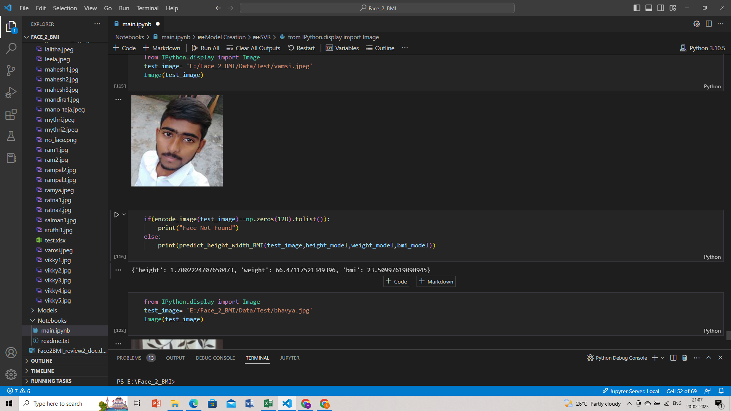
Prediction on Test Image

